Slide 1
Intrusion Handling
Submitted By - Shradha 57
Ankuj 09

Slide 2
What is Intrusion?
The act of intruding or the state of being intruded especially the act of wrongfully entering upon, seizing, or taking possession of the property of another is called intrusion.
Intruders are often referred to as hacker, who have immense knowledge and an in-depth understanding of technology and security
They are the most harmful factors contributing to the vulnerability of security.
Intruders breach the privacy of users, steal their confidential information and sell it to the third-party, which aim at misusing the information for their own personal or professional gains.

Slide 3
Types of Intruders
Masquerader: The category of individuals that are not authorized to use the system but still exploit user’s privacy and confidential information by possessing techniques that give them control over the system
Misfeasor: The category of individuals that are authorized to use the system, but misuse the granted access and privilege.
Clandestine User: The category of individuals those have supervision/administrative control over the system and misuse the authoritative power given to them. The misconduct of power is often done by superlative authorities for financial gains.

Slide 4
Approaches to Intrusion Detection and Prevention
1. Preemptive Blocking : It is also called Banishment vigilance. It seeks to prevent intrusion from happening before they occur. The above method is done by observing any danger signs of imminent threats and then blocking user or IP address from which these signs originate.
If Admin finds that particular IP address is source of frequent port scans and other scans of their system then they will block that IP address at firewall. The above intrusion detection and avoidance can be quite complicated which could potentially block legitimate user by mistake. This can lead to problem of false positives, in which system mistakenly identifies legitimate traffic as some form of attack.

Slide 5
2. Anomaly Detection : It involves actual software that works to detect intrusion attempts and then notify the administrator. The general process is simple, system looks for any abnormal behaviour.
Any activity that does not match pattern of normal user access is noted and logged. Any activity that does not match definition of normal behaviour is considered an anomaly and is logged. It is also called as “traceback” process.
The specific ways in which an anomaly is detected includes Threshold Monitoring, Resource Profiling, User/Group Work Profiling, and Executable Profiling.

Slide 6
Intrusion Detection System (IDS)
An Intrusion Detection System (IDS) is a system that monitors network traffic for suspicious activity and issues alerts when such activity is discovered.
Any malicious venture or violation is normally reported either to an administrator or collected centrally using a security information and event management (SIEM) system. This system integrates outputs from multiple sources and uses alarm filtering techniques to differentiate malicious activity from false alarms.
IDS can also disposed to false alarms. Hence, organizations need to fine-tune their IDS products when they first install them so that the normal traffic on the network can be differentiated from malicious activity.

Slide 7
Classification of IDS
1. Network Intrusion Detection System (NIDS) - runs within the network.
2. Host Intrusion Detection System (HIDS) - runs on independent hosts or devices.
3. Protocol-based Intrusion Detection System (PIDS) - at the front end of the server.
4. Application Protocol-based Intrusion Detection System (APIDS) - resides within a group of servers.
5. Hybrid Intrusion Detection System - mix of one or many approaches.

Slide 8
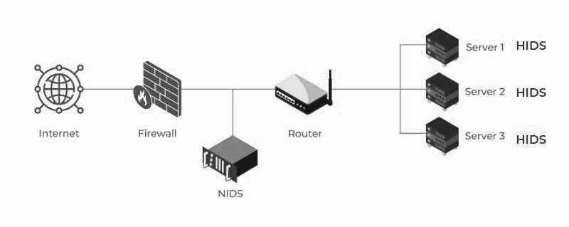
NIDS and HIDS

Slide 9
Detection Method of IDS
1. Signature-based Method : Signature-based IDS detects the attacks on the basis of the specific patterns such as number of bytes or number of 1’s or number of 0’s in the network traffic or the already known malicious instruction sequence. it is quite difficult for them to detect the new malware attacks as their pattern (signature) is not known.
2. Anomaly-based Method : Anomaly-based IDS was introduced to detect unknown malware attacks as new malware are developed rapidly. There is the use of machine learning to create a trustful model which can detect any suspicious activity. Machine learning-based models can be trained according to the applications and hardware configurations thus are better in comparison to signature-based IDS.

Slide 10
Intrusion Prevention System (IPS)
Intrusion Prevention System is also known as Intrusion Detection and Prevention System. It is a network security application that monitors network or system activities for malicious activity by identifying it, collecting information about it,, report it and attempt to block or stop it.
Intrusion prevention systems are contemplated as augmentation of Intrusion Detection Systems (IDS) because both IPS and IDS operate network traffic and system activities for malicious activity.
Many IPS can also respond to a detected threat by attempting to prevent it from succeeding. They use various response techniques, which involve the IPS stopping the attack itself, changing the security environment or changing the attack’s content.

Slide 11
Classification of IPS
1. Network-based intrusion prevention system (NIPS) - monitors the entire network for suspicious traffic by analysing protocol activity.
2. Wireless intrusion prevention system (WIPS) - monitors a wireless network for suspicious traffic by analysing wireless networking protocols.
3. Network behaviour analysis (NBA) - examines network traffic to identify threats that generate unusual traffic flows, such as DDOS attacks, specific forms of malware and policy violations.
4. Host-based intrusion prevention system (HIPS) - inbuilt software package which operates a single host for doubtful activity by scanning events that occur within that host.

Slide 12
Detection Method of IPS
1. Signature-based detection : Signature-based IDS operates packets in the network and compares with pre-built and preordained attack patterns known as signatures.
2. Statistical anomaly-based detection : Anomaly based IDS monitors network traffic and compares it against an established baseline. The baseline will identify what is normal for that network and what protocols are used. However, It may raise a false alarm if the baselines are not intelligently configured.
3. Stateful protocol analysis detection : This IDS method recognizes divergence of protocols stated by comparing observed events with pre-built profiles of generally accepted definitions of not harmful activity.

Slide 13
Comparison of IPS with IDS
The main difference between Intrusion Prevention System (IPS) with Intrusion Detection Systems (IDS) are:
1. Intrusion prevention systems are placed in-line and are able to actively prevent or block intrusions that are detected.
2. IPS can take such actions as sending an alarm, dropping detected malicious packets, resetting a connection or blocking traffic from the offending IP address.
3. IPS also can correct cyclic redundancy check (CRC) errors, defragment packet streams, mitigate TCP sequencing issues and clean up unwanted transport and network layer options.

Slide 14
Thank You!

